Slide 1
C/C++ Unit Test
Notes:
2013-08-08
Alaram Automatic Clearing DHCP Option 100 support in NACF
11/11/262011-11-28
CBC/XYD-11:0057 Uen, Rev PA1 CBC/XDS-11:0057 Uen, Rev A

Slide 2
Agenda
Context
Example/Exercise
Mock/Exercise
UT FW demo
Notes:
2013-08-08
Alaram Automatic Clearing DHCP Option 100 support in NACF
11/11/262011-11-28
CBC/XYD-11:0057 Uen, Rev PA1 CBC/XDS-11:0057 Uen, Rev A

Slide 3
Conext
Source code means application codes
Test code means unit test case codes
Assume environment is ready according to https://wiki.lmera.ericsson.se/wiki/CodingWithMe/c++UnitTest
Notes:
2013-08-08
Alaram Automatic Clearing DHCP Option 100 support in NACF
11/11/262011-11-28
CBC/XYD-11:0057 Uen, Rev PA1 CBC/XDS-11:0057 Uen, Rev A

Slide 4
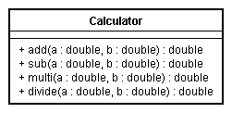
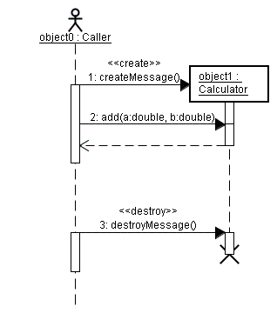
Example(TestApp1)
First version of class “Calculator”
Notes:
2013-08-08
Alaram Automatic Clearing DHCP Option 100 support in NACF
11/11/262011-11-28
CBC/XYD-11:0057 Uen, Rev PA1 CBC/XDS-11:0057 Uen, Rev A

Slide 5
Example(TestApp1)
How to do unit test for class “Calculator”
  Solution1: From function “main” to test it, please see codes in TestApp1/src/Main.cpp
  Solution2: Import unit test framework(Boost Or GTest), please see codes in TestApp1/test/src/TestCalculator.cpp
  How to get coverage
  Gcor
  Lcov
  Eclipse built-in plugin( demo in this example)
  Exercise
  Please add more test cases in TestCalculator.cpp to improve coverage
  If some defects in source codes are found by writing test cases, please fix them
  Q: Is it really needed to package source codes in library as “libapp.a”?
Notes:
2013-08-08
Alaram Automatic Clearing DHCP Option 100 support in NACF
11/11/262011-11-28
CBC/XYD-11:0057 Uen, Rev PA1 CBC/XDS-11:0057 Uen, Rev A

Slide 6
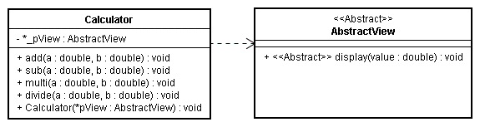
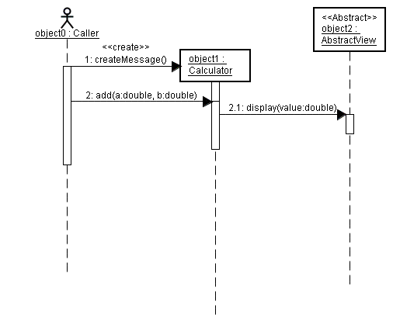
Mock(TestApp2)
Second version of class “Calculator” in TestApp2
Notes:
2013-08-08
Alaram Automatic Clearing DHCP Option 100 support in NACF
11/11/262011-11-28
CBC/XYD-11:0057 Uen, Rev PA1 CBC/XDS-11:0057 Uen, Rev A

Slide 7
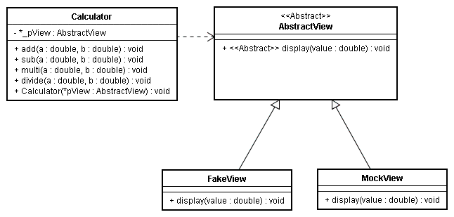
Mock(TestApp2)
  How to do unit test for new version “Calculator”
  One solution is to create a new fake class like “FakeView” to simulate all actions in “AbstractView” needed by “Calculator”
  Another solution: import mock libraries(Turtle or GMock)
  Refer to TestApp2 codes to see more details.
Notes:
2013-08-08
Alaram Automatic Clearing DHCP Option 100 support in NACF
11/11/262011-11-28
CBC/XYD-11:0057 Uen, Rev PA1 CBC/XDS-11:0057 Uen, Rev A

Slide 8
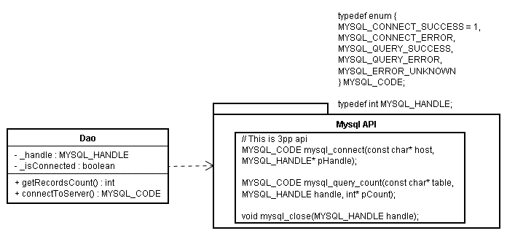
Mock(TestApp2)
  Exercise(Dao)
  Please refactor class “Dao” in TestApp2 and add more test cases in TestApp2/test/src/TestDao.cpp
  Refer to previous “Calculator” to import mock lib to help you
Notes:
2013-08-08
Alaram Automatic Clearing DHCP Option 100 support in NACF
11/11/262011-11-28
CBC/XYD-11:0057 Uen, Rev PA1 CBC/XDS-11:0057 Uen, Rev A

Slide 9
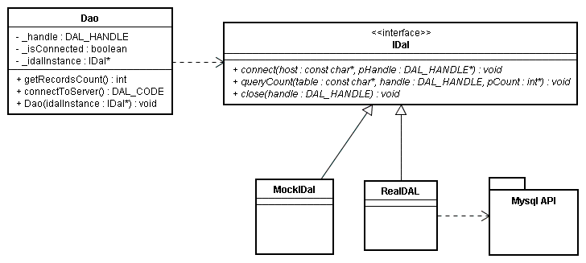
Mock(TestApp2)
  Exercise(Dao)
  Refer to TestApp3
Notes:
2013-08-08
Alaram Automatic Clearing DHCP Option 100 support in NACF
11/11/262011-11-28
CBC/XYD-11:0057 Uen, Rev PA1 CBC/XDS-11:0057 Uen, Rev A

Slide 10
UT FW demo
  CUDB UT FW demo
Notes:
2013-08-08
Alaram Automatic Clearing DHCP Option 100 support in NACF
11/11/262011-11-28
CBC/XYD-11:0057 Uen, Rev PA1 CBC/XDS-11:0057 Uen, Rev A

Slide 11
Reference
http://cppcheck.sourceforge.net/
http://code.google.com/p/googletest/
http://opensource.org/licenses/BSD-3-Clause
http://turtle.sourceforge.net/
http://www.boost.org/doc/libs/1_54_0/libs/test/doc/html/index.html
http://code.google.com/p/gmock/
https://software.sandia.gov/trac/fast/wiki/gcovr
http://gcc.gnu.org/onlinedocs/gcc/Gcov.html
http://ant.apache.org/
http://www.sonarsource.org/
Notes:
2013-08-08
Alaram Automatic Clearing DHCP Option 100 support in NACF
11/11/262011-11-28
CBC/XYD-11:0057 Uen, Rev PA1 CBC/XDS-11:0057 Uen, Rev A

Slide 12

Notes:
2013-08-08
Alaram Automatic Clearing DHCP Option 100 support in NACF
11/11/262011-11-28
CBC/XYD-11:0057 Uen, Rev PA1 CBC/XDS-11:0057 Uen, Rev A

